Slide 1
Map-Reduce Graph Processing
Adapted from UMD Jimmy Lin’s slides, which is licensed under a Creative Commons Attribution-Noncommercial-Share Alike 3.0 United States. See http://creativecommons.org/licenses/by-nc-sa/3.0/us/ for details

Slide 2
Roadmap
Graph problems and representations
Parallel breadth-first search
PageRank

Slide 3
What’s a graph?
G = (V,E), where
V represents the set of vertices (nodes)
E represents the set of edges (links)
Both vertices and edges may contain additional information
Different types of graphs:
Directed vs. undirected edges
Presence or absence of cycles
Graphs are everywhere:
Hyperlink structure of the Web
Physical structure of computers on the Internet
Interstate highway system
Social networks

Slide 4
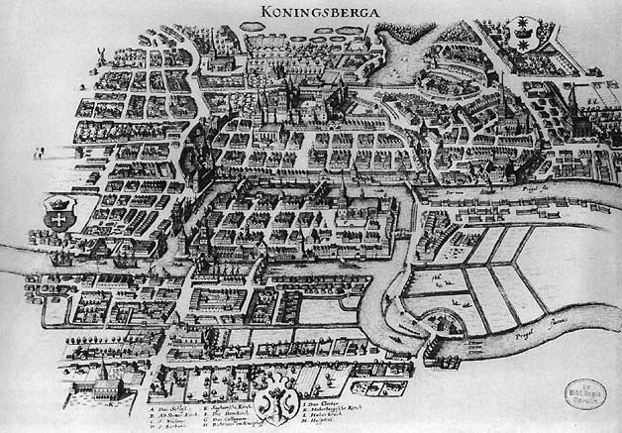
Source: Wikipedia (Königsberg)

Slide 5
Some Graph Problems
Finding shortest paths
Routing Internet traffic and UPS trucks
Finding minimum spanning trees
Telco laying down fiber
Finding Max Flow
Airline scheduling
Identify “special” nodes and communities
Breaking up terrorist cells, spread of avian flu
Bipartite matching
Monster.com, Match.com
And of course... PageRank

Slide 6
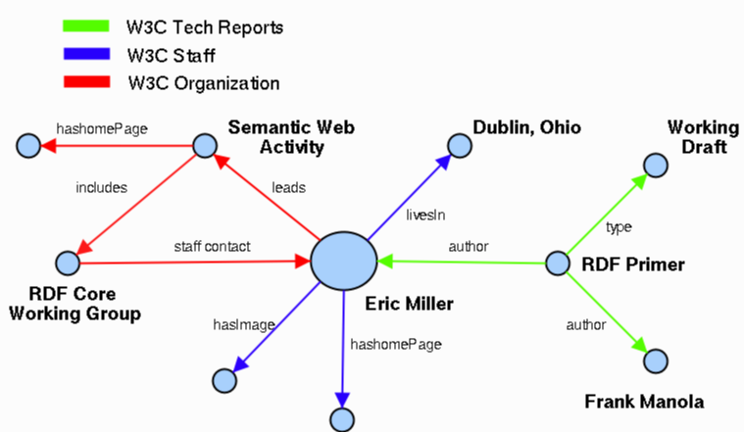

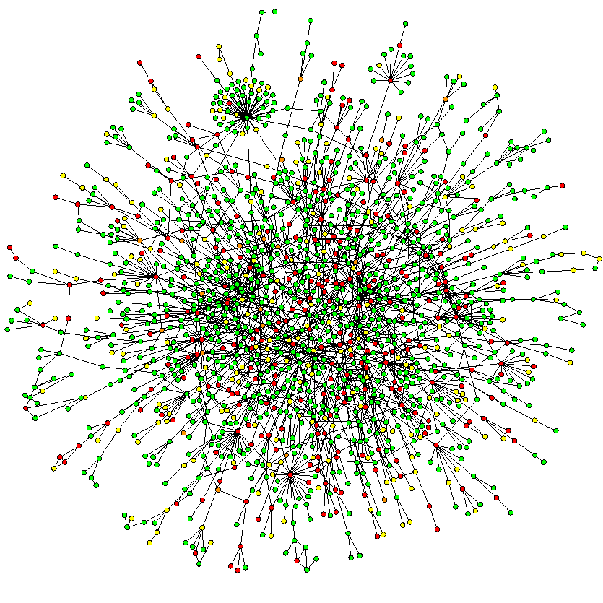

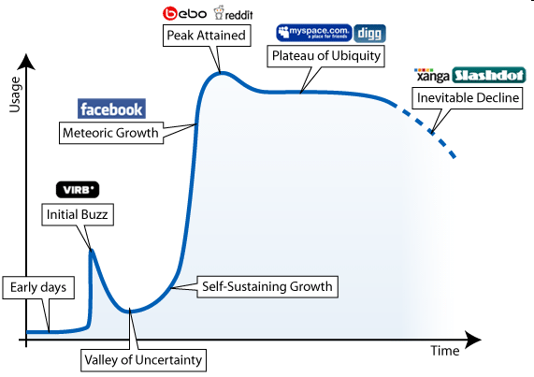


Ubiquitous Network (Graph) Data
Social Network
Biological Network
Road Network/Map
WWW
Sematic Web/Ontologies
XML/RDF
….
Semantic Search, Guha et. al., WWW’03
http://belanger.wordpress.com/2007/06/28/ the-ebb-and-flow-of-social-networking/
6
Notes:
6

Slide 7
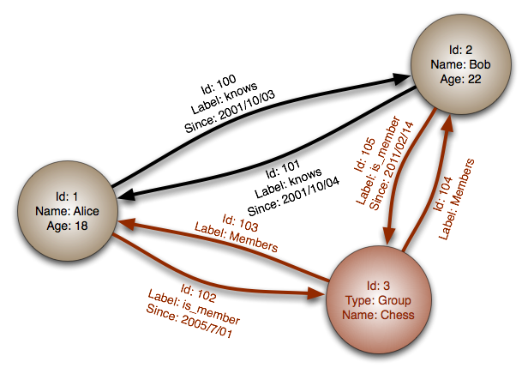

Slide 8
Graph (and Relational) Analytics
General Graph
Count the number of nodes whose degree is equal to 5
Find the diameter of the graphs
Web Graph
Rank each webpage in the webgraph or each user in the twitter graph using PageRank, or other centrality measure
Transportation Network
Return the shortest or cheapest flight/road from one city to another
Social Network
Determine whether there is a path less than 4 steps which connects two users in a social network
Financial Network
Find the path connecting two suspicious transactions;
Temporal Network
Compute the number of computers who were affected by a particular computer virus in three days, thirty days since its discovery

Slide 9
Challenge in Dealing with Graph Data
Flat Files
No Query Support
RDBMS
Can Store the Graph
Limited Support for Graph Query
Connect-By (Oracle)
Common Table Expressions (CTEs) (Microsoft)
Temporal Table

Slide 10
Native Graph Databases
Emerging Field
http://en.wikipedia.org/wiki/Graph_database
Storage and Basic Operators
Neo4j (an open source graph database)
InfiniteGraph
VertexDB
Distributed Graph Processing (mostly in-memory-only)
Google’s Pregel (vertex centered computation)

Slide 11
Graph analytics industry practice status
Graph data in many industries
Graph analytics are powerful and can bring great business values/insights
Graph analytics not utilized enough in enterprises due to lack of available platforms/tools (except leading tech companies which have high caliber in house engineering teams and resources)

Slide 12
Graphs and MapReduce
Graph algorithms typically involve:
Performing computations at each node: based on node features, edge features, and local link structure
Propagating computations: “traversing” the graph
Key questions:
How do you represent graph data in MapReduce?
How do you traverse a graph in MapReduce?

Slide 13
Representing Graphs
G = (V, E)
Two common representations
Adjacency matrix
Adjacency list

Slide 14
Adjacency Matrices
Represent a graph as an n x n square matrix M
n = |V|
M_{ij} = 1 means a link from node i to j
2
 | 1 | 2 | 3 | 4
1 | 0 | 1 | 0 | 1
2 | 1 | 0 | 1 | 1
3 | 1 | 0 | 0 | 0
4 | 1 | 0 | 1 | 0
1
3
4

Slide 15
Adjacency Matrices: Critique
Advantages:
Amenable to mathematical manipulation
Iteration over rows and columns corresponds to computations on outlinks and inlinks
Disadvantages:
Lots of zeros for sparse matrices
Lots of wasted space

Slide 16
Adjacency Lists
Take adjacency matrices… and throw away all the zeros
 | 1 | 2 | 3 | 4
1 | 0 | 1 | 0 | 1
2 | 1 | 0 | 1 | 1
3 | 1 | 0 | 0 | 0
4 | 1 | 0 | 1 | 0
1: 2, 4
2: 1, 3, 4
3: 1
4: 1, 3

Slide 17
Adjacency Lists: Critique
Advantages:
Much more compact representation
Easy to compute over outlinks
Disadvantages:
Much more difficult to compute over inlinks

Slide 18
Single Source Shortest Path
Problem: find shortest path from a source node to one or more target nodes
Shortest might also mean lowest weight or cost
First, a refresher: Dijkstra’s Algorithm

Slide 19
Dijkstra’s Algorithm Example
∞
1
∞
10
0
2
3
9
4
6
5
7
∞
∞
2
Example from CLR

Slide 20
Dijkstra’s Algorithm Example
10
1
∞
10
0
2
3
9
4
6
5
7
5
∞
2
Example from CLR

Slide 21
Dijkstra’s Algorithm Example
8
1
14
10
0
2
3
9
4
6
5
7
5
7
2
Example from CLR

Slide 22
Dijkstra’s Algorithm Example
8
1
13
10
0
2
3
9
4
6
5
7
5
7
2
Example from CLR

Slide 23
Dijkstra’s Algorithm Example
8
1
9
1
10
0
2
3
9
4
6
5
7
5
7
2
Example from CLR

Slide 24
Dijkstra’s Algorithm Example
8
1
9
10
0
2
3
9
4
6
5
7
5
7
2
Example from CLR

Slide 25
Single Source Shortest Path
Problem: find shortest path from a source node to one or more target nodes
Shortest might also mean lowest weight or cost
Single processor machine: Dijkstra’s Algorithm
MapReduce: parallel Breadth-First Search (BFS)

Slide 26

Source: Wikipedia (Wave)

Slide 27
Finding the Shortest Path
Consider simple case of equal edge weights
Solution to the problem can be defined inductively
Here’s the intuition:
Define: b is reachable from a if b is on adjacency list of a
DistanceTo(s) = 0
For all nodes p reachable from s, DistanceTo(p) = 1
For all nodes n reachable from some other set of nodes M, DistanceTo(n) = 1 + min(DistanceTo(m), m ∈ M)
d₁
m₁
…
d₂
s
…
n
m₂
…
d₃
m₃

Slide 28
Visualizing Parallel BFS
n₇
n₀
n₁
n₃
n₂
n₆
n₅
n₄
n₈
n₉

Slide 29
From Intuition to Algorithm
Data representation:
Key: node n
Value: d (distance from start), adjacency list (list of nodes reachable from n)
Initialization: for all nodes except for start node, d = ∞
Mapper:
∀m ∈ adjacency list: emit (m, d + 1)
Sort/Shuffle
Groups distances by reachable nodes
Reducer:
Selects minimum distance path for each reachable node
Additional bookkeeping needed to keep track of actual path

Slide 30
Multiple Iterations Needed
Each MapReduce iteration advances the “known frontier” by one hop
Subsequent iterations include more and more reachable nodes as frontier expands
Multiple iterations are needed to explore entire graph
Preserving graph structure:
Problem: Where did the adjacency list go?
Solution: mapper emits (n, adjacency list) as well

Slide 31
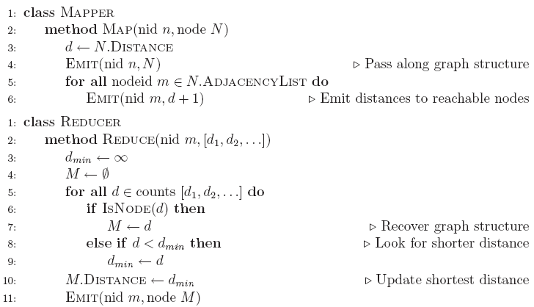
BFS Pseudo-Code

Slide 32
Stopping Criterion
How many iterations are needed in parallel BFS (equal edge weight case)?
Convince yourself: when a node is first “discovered”, we’ve found the shortest path
Now answer the question...
Six degrees of separation?
Practicalities of implementation in MapReduce

Slide 33
Comparison to Dijkstra
Dijkstra’s algorithm is more efficient
At any step it only pursues edges from the minimum-cost path inside the frontier
MapReduce explores all paths in parallel
Lots of “waste”
Useful work is only done at the “frontier”
Why can’t we do better using MapReduce?

Slide 34
Weighted Edges
Now add positive weights to the edges
Why can’t edge weights be negative?
Simple change: adjacency list now includes a weight w for each edge
In mapper, emit (m, d + w_{p}) instead of (m, d + 1) for each node m
That’s it?

Slide 35
Stopping Criterion
How many iterations are needed in parallel BFS (positive edge weight case)?
Convince yourself: when a node is first “discovered”, we’ve found the shortest path
Not true!

Slide 36
Additional Complexities
search frontier
1
n₆
1
n₇
1
n₈
r
10
1
n₅
n₉
n₁
s
1
1
p
q
n₄
1
n₂
1
n₃

Slide 37
Stopping Criterion
How many iterations are needed in parallel BFS (positive edge weight case)?
Practicalities of implementation in MapReduce

Slide 38
Graphs and MapReduce
Graph algorithms typically involve:
Performing computations at each node: based on node features, edge features, and local link structure
Propagating computations: “traversing” the graph
Generic recipe:
Represent graphs as adjacency lists
Perform local computations in mapper
Pass along partial results via outlinks, keyed by destination node
Perform aggregation in reducer on inlinks to a node
Iterate until convergence: controlled by external “driver”
Don’t forget to pass the graph structure between iterations

Slide 39
http://famousphil.com/blog/2011/06/a-hadoop-mapreduce-solution-to-dijkstra%E2%80%99s-algorithm/
public class Dijkstra extends Configured implements Tool {
public static String OUT = "outfile";
public static String IN = "inputlarger”;
public static class TheMapper extends Mapper<LongWritable, Text, LongWritable, Text> {
public void map(LongWritable key, Text value, Context context) throws IOException, InterruptedException {
Text word = new Text();
String line = value.toString();//looks like 1 0 2:3:
String[] sp = line.split(" ");//splits on space
int distanceadd = Integer.parseInt(sp[1]) + 1;
String[] PointsTo = sp[2].split(":");
for(int i=0; i<PointsTo.length; i++){
word.set("VALUE "+distanceadd);//tells me to look at distance value
context.write(new LongWritable(Integer.parseInt(PointsTo[i])), word);
word.clear(); }
//pass in current node's distance (if it is the lowest distance)
word.set("VALUE "+sp[1]);
context.write( new LongWritable( Integer.parseInt( sp[0] ) ), word );
word.clear();
word.set("NODES "+sp[2]);//tells me to append on the final tally
context.write( new LongWritable( Integer.parseInt( sp[0] ) ), word );
word.clear();
}
}

Slide 40
public static class TheReducer extends Reducer<LongWritable, Text, LongWritable, Text> {
public void reduce(LongWritable key, Iterable<Text> values, Context context) throws IOException, InterruptedException {
String nodes = "UNMODED";
Text word = new Text();
int lowest = 10009;//start at infinity
for (Text val : values) {//looks like NODES/VALUES 1 0 2:3:, we need to use the first as a key
String[] sp = val.toString().split(" ");//splits on space
//look at first value
if(sp[0].equalsIgnoreCase("NODES")){
nodes = null;
nodes = sp[1];
}else if(sp[0].equalsIgnoreCase("VALUE")){
int distance = Integer.parseInt(sp[1]);
lowest = Math.min(distance, lowest);
}
}
word.set(lowest+" "+nodes);
context.write(key, word);
word.clear();
}
}

Slide 41
public int run(String[] args) throws Exception {
//http://code.google.com/p/joycrawler/source/browse/NetflixChallenge/src/org/niubility/learning/knn/KNNDriver.java?r=242
getConf().set("mapred.textoutputformat.separator", " ");//make the key -> value space separated (for iterations)
…..
while(isdone == false){
Job job = new Job(getConf());
job.setJarByClass(Dijkstra.class);
job.setJobName("Dijkstra");
job.setOutputKeyClass(LongWritable.class);
job.setOutputValueClass(Text.class);
job.setMapperClass(TheMapper.class);
job.setReducerClass(TheReducer.class);
job.setInputFormatClass(TextInputFormat.class);
job.setOutputFormatClass(TextOutputFormat.class);
FileInputFormat.addInputPath(job, new Path(infile));
FileOutputFormat.setOutputPath(job, new Path(outputfile));
success = job.waitForCompletion(true);
//remove the input file
//http://eclipse.sys-con.com/node/1287801/mobile
if(infile != IN){
String indir = infile.replace("part-r-00000", "");
Path ddir = new Path(indir);
FileSystem dfs = FileSystem.get(getConf());
dfs.delete(ddir, true);
}

Slide 42
Random Walks Over the Web
Random surfer model:
User starts at a random Web page
User randomly clicks on links, surfing from page to page
PageRank
Characterizes the amount of time spent on any given page
Mathematically, a probability distribution over pages
PageRank captures notions of page importance
Correspondence to human intuition?
One of thousands of features used in web search
Note: query-independent

Slide 43
PageRank: Defined
Given page x with inlinks t₁…t_{n}, where
C(t) is the out-degree of t
α is probability of random jump
N is the total number of nodes in the graph
t₁
X
t₂
…
t_{n}

Slide 44
Example: The Web in 1839
y a m
Yahoo
y 1/2 1/2 0
a 1/2 0 1
m 0 1/2 0
Amazon
M’soft

Slide 45
Simulating a Random Walk
Start with the vector v = [1,1,…,1] representing the idea that each Web page is given one unit of importance.
Repeatedly apply the matrix M to v, allowing the importance to flow like a random walk.
Limit exists, but about 50 iterations is sufficient to estimate final distribution.

Slide 46
Example
Equations v = M v :
y = y /2 + a /2
a = y /2 + m
m = a /2
y
a =
m
1
1
1
1
3/2
1/2
5/4
1
3/4
9/8
11/8
1/2
6/5
6/5
3/5
. . .

Slide 47
Solving The Equations
Because there are no constant terms, these 3 equations in 3 unknowns do not have a unique solution.
Add in the fact that y +a +m = 3 to solve.
In Web-sized examples, we cannot solve by Gaussian elimination; we need to use relaxation (= iterative solution).

Slide 48
Real-World Problems
Some pages are “dead ends” (have no links out).
Such a page causes importance to leak out.
Other (groups of) pages are spider traps (all out-links are within the group).
Eventually spider traps absorb all importance.

Slide 49
Microsoft Becomes Dead End
y a m
Yahoo
y 1/2 1/2 0
a 1/2 0 0
m 0 1/2 0
Amazon
M’soft

Slide 50
Example
Equations v = M v :
y = y /2 + a /2
a = y /2
m = a /2
y
a =
m
1
1
1
1
1/2
1/2
3/4
1/2
1/4
5/8
3/8
1/4
0
0
0
. . .

Slide 51
M’soft Becomes Spider Trap
y a m
Yahoo
y 1/2 1/2 0
a 1/2 0 0
m 0 1/2 1
Amazon
M’soft

Slide 52
Example
Equations v = M v :
y = y /2 + a /2
a = y /2
m = a /2 + m
y
a =
m
1
1
1
1
1/2
3/2
3/4
1/2
7/4
5/8
3/8
2
0
0
3
. . .

Slide 53
Google Solution to Traps, Etc.
“Tax” each page a fixed percentage at each interation.
Add the same constant to all pages.
Models a random walk with a fixed probability of going to a random place next.

Slide 54
Example: Previous with 20% Tax
Equations v = 0.8(M v ) + 0.2:
y = 0.8(y /2 + a/2) + 0.2
a = 0.8(y /2) + 0.2
m = 0.8(a /2 + m) + 0.2
y
a =
m
1
1
1
1.00
0.60
1.40
0.84
0.60
1.56
0.776
0.536
1.688
7/11
5/11
21/11
. . .

Slide 55
Computing PageRank
Properties of PageRank
Can be computed iteratively
Effects at each iteration are local
Sketch of algorithm:
Start with seed PR_{i} values
Each page distributes PR_{i} “credit” to all pages it links to
Each target page adds up “credit” from multiple in-bound links to compute PR_{i+1}
Iterate until values converge

Slide 56
Sample PageRank Iteration (1)
Iteration 1
n₂ (0.2)
n₂ (0.166)
n₁ (0.2)
0.1
0.1
0.1
n₁ (0.066)
0.1
0.066
0.066
0.066
n₅ (0.2)
n₃ (0.2)
n₅ (0.3)
n₃ (0.166)
0.2
0.2
n₄ (0.2)
n₄ (0.3)

Slide 57
Sample PageRank Iteration (2)
Iteration 2
n₂ (0.166)
n₂ (0.133)
n₁ (0.066)
0.033
0.083
0.083
n₁ (0.1)
0.033
0.1
0.1
0.1
n₅ (0.3)
n₃ (0.166)
n₅ (0.383)
n₃ (0.183)
0.3
0.166
n₄ (0.3)
n₄ (0.2)

Slide 58
PageRank in MapReduce
n₁ [n₂, n₄]
n₂ [n₃, n₅]
n₃ [n₄]
n₄ [n₅]
n₅ [n₁, n₂, n₃]
Map
n₂
n₄
n₃
n₅
n₄
n₅
n₁
n₂
n₃
n₁
n₂
n₂
n₃
n₃
n₄
n₄
n₅
n₅
Reduce
n₁ [n₂, n₄]
n₂ [n₃, n₅]
n₃ [n₄]
n₄ [n₅]
n₅ [n₁, n₂, n₃]

Slide 59
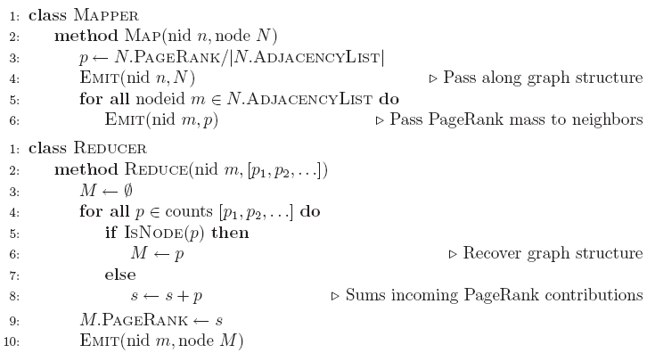
PageRank Pseudo-Code

Slide 60
Complete PageRank
Two additional complexities
What is the proper treatment of dangling nodes?
How do we factor in the random jump factor?
Solution:
Second pass to redistribute “missing PageRank mass” and account for random jumps
p is PageRank value from before, p' is updated PageRank value
|G| is the number of nodes in the graph
m is the missing PageRank mass

Slide 61
PageRank Convergence
Alternative convergence criteria
Iterate until PageRank values don’t change
Iterate until PageRank rankings don’t change
Fixed number of iterations
Convergence for web graphs?

Slide 62
Beyond PageRank
Link structure is important for web search
PageRank is one of many link-based features: HITS, SALSA, etc.
One of many thousands of features used in ranking…
Adversarial nature of web search
Link spamming
Spider traps
Keyword stuffing
…

Slide 63
Efficient Graph Algorithms
Sparse vs. dense graphs
Graph topologies

Slide 64
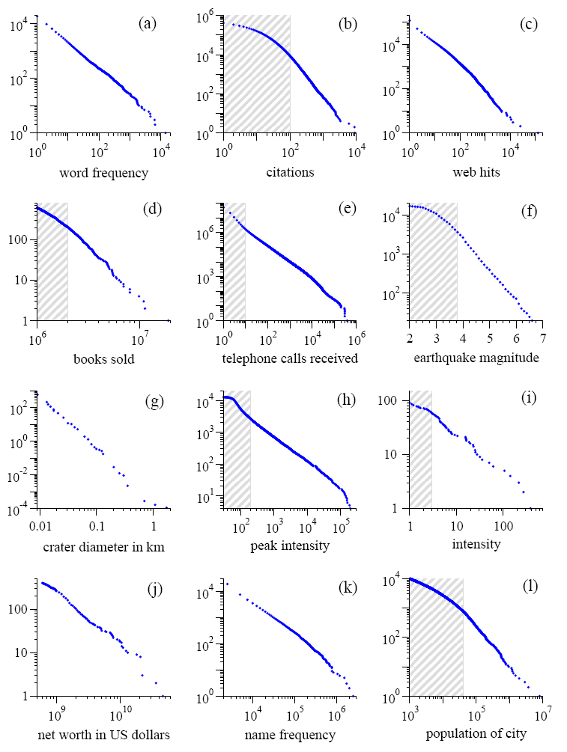
Power Laws are everywhere!
Figure from: Newman, M. E. J. (2005) “Power laws, Pareto distributions and Zipf's law.” Contemporary Physics 46:323–351.

Slide 65
Local Aggregation
Use combiners!
In-mapper combining design pattern also applicable
Maximize opportunities for local aggregation
Simple tricks: sorting the dataset in specific ways

